Slide 1
Graph - Review

Slide 2
Graph - Review
Graph, simple graph, directed graph, undirected graph, multigraph, multi edges, loops, weighted graph
Degree and Handshaking Theorem
Graph Representations
Path and circuit
Connected graph (directed and undirected), connected components
Special graphs
Euler path, circuit
Hamiltonian path, circuit

Slide 3
Sample Questions
Prove that the sum of the degrees of the vertices of simple graph is even
Prove that every simple graph has two vertices of the same degree
Prove that a complete graph K_{n} is not a bipartite (n ≥3)
When a cycle graph is a bipartite graph?
Prove that n-cube graph is bipartite?
How many vertices are there in a complete graph, denoted by K_{n}?

Slide 4
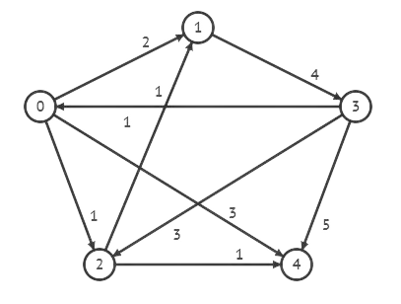
Questions
What is the adjacency Matrix of the following graph?

Slide 5
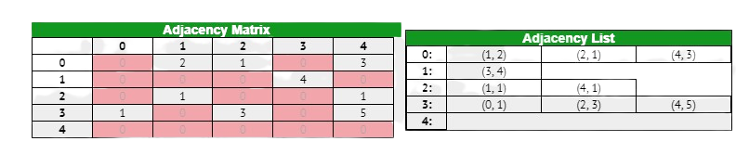
Questions
What is the adjacency Matrix of the following graph?

Slide 6
DFS - BFS

Slide 7
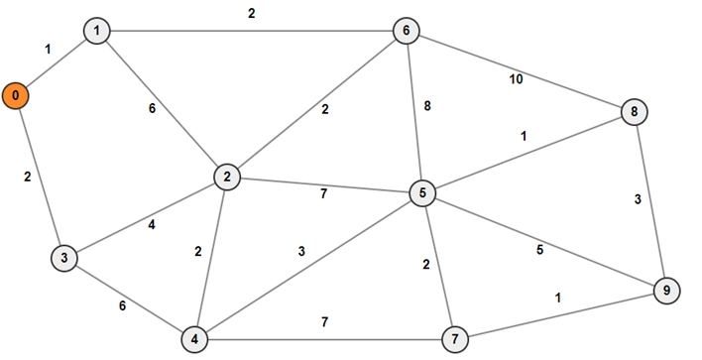

Slide 8
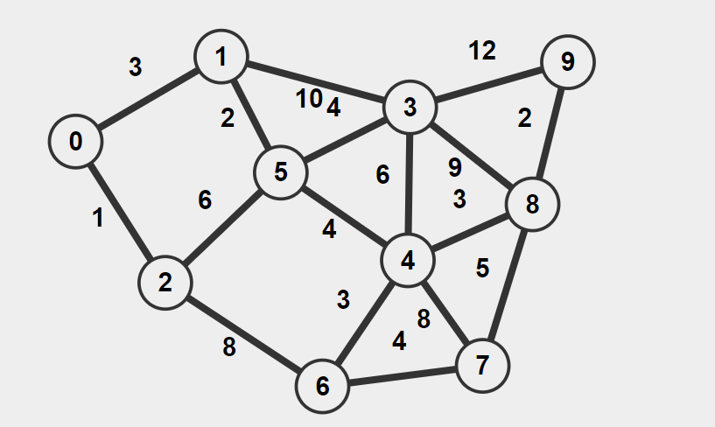

Slide 9
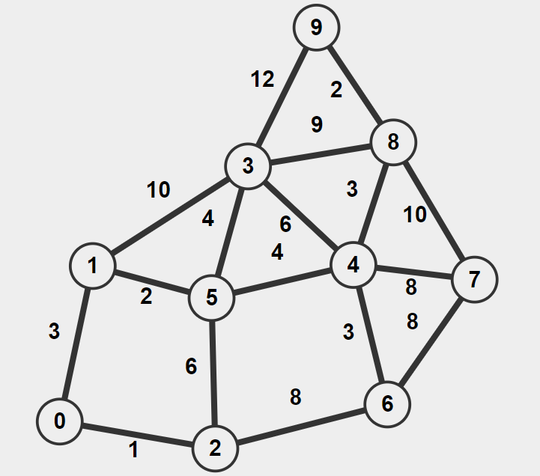

Slide 10
